Slide 1
Working Area

Slide 2
Hi, I’m your artboard
Let’s add a few slides

Slide 3
Please change the background

Slide 4
Coloring features

Slide 5
Adding a Fill
Adding borders
Adding a shadow

Slide 6
Selection Pane & arrangement

Slide 7
Text Box #1
Text Box #3
Text Box #2
Notes:
Open Selection Pane – Explain the pane
Show the hide and lock feature
Learn the Arrange feature
Rename boxes and showcase it with an animation

Slide 8
Drag & Drop

Slide 9
Drag a picture
Insert an PNG Icon
Insert an SVG Icon (EMF if you have 2016 or older)
Showcase the STOCK features for 365 users
Notes:
I used those websites:
https://uxwing.com/
https://unsplash.com/

Slide 10
Working with Images

Slide 11
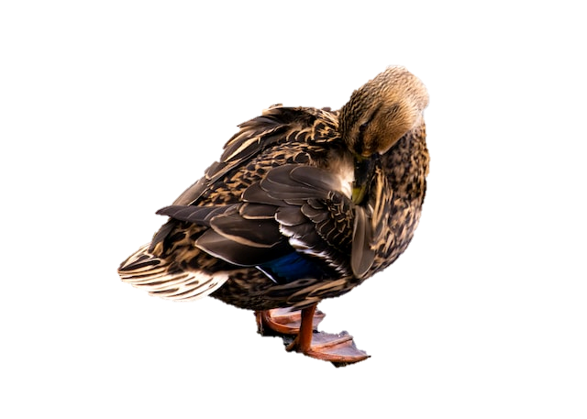


Remove Background
Corrections
Cropping
Notes:
Removing the background
Corrections, colors and effects
Cropping and adjusting to shape

Slide 12
Format Panel

Slide 13

Welcome welcome

Slide 14
Guides & Rulers

Slide 15
Enable ruler
Enable and edit guides
Notes:
Show how to enable a ruler
Show how to add guides
Establish a few simple guides

Slide 16


Your task
Practice here

